Slide 1
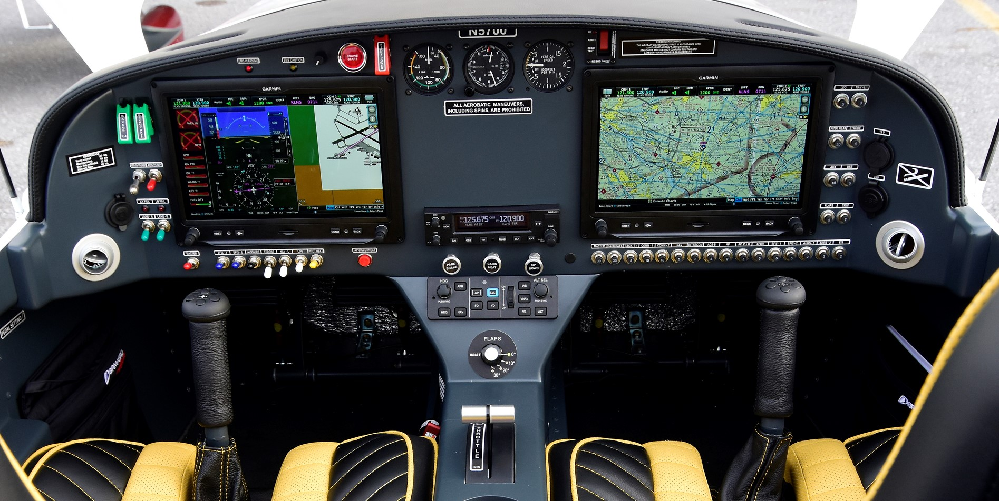
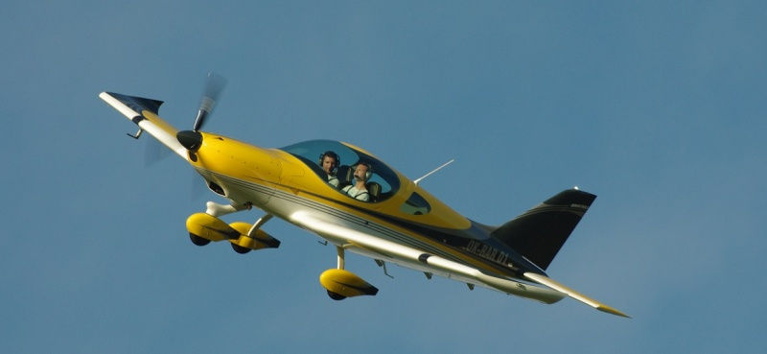
182/2016 Bristell LSA 2017 N183BL LIST $205,738,500 800TT $159,108
912iS Rotax 100 HP Engine, 770 TT, Gear Box O/H @750TT
Ground adjustable Fiti Propeller, Wheel Fairings
Berringer Toe Brakes, Park brake, Electric trim
Dual G3X Touch, 2 ADHARS, two inch back up A/S ALT
GMC 245 AUDIO PANEL, GTR20R COM,
GTX23 ES TXP, 20A GPS, RS 232 INTERFACE
ADS-B in & out, GNC 255A Com/Nav/ILS/GPS
2 Axis Autopilot with GMC 507 Module, Yaw dampener
Grey tinted canopy , Mac 205, Hobbs meter
Flush Rivetted wing, heated pitot
Charcoal grey interior paint,
Yellow seats with black inserts and piping
Black arm rests with yellow stitching
Annual good until Dec 2021
Lou Mancuso 516-658-1847

